Slide 1

Study, modeling and simulation of pedestrian walk with regard to the improvement of stability and comfort on walkways
School of Electrical & Computer Engineering
Implementation Report
Pavlos Paris Giakoumakis
AM: $2013030045$
Thesis project - Erasmus+ internship at University of Modena & Reggio Emilia (UNIMORE)

Slide 2
Goals
Calibration of the database that consists of valid measurements for 215 pedestrians
Extraction of the appropriate variables describing the human gait
Statistical modeling of variables taking all database samples into consideration
Extraction of statistical model of parameters
Development of a gait simulator based on the statistical model – Extraction of variables for a defined number of steps

Slide 3
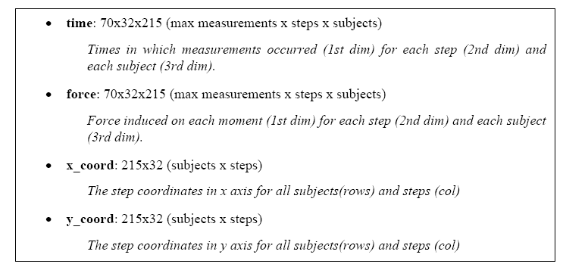
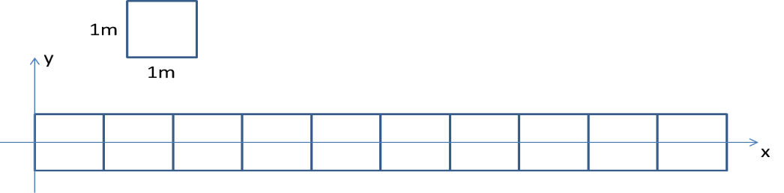

The Database
Includes measurements of $2$ traverses in a $10x1$m walkway for $215$ pedestrians in a variety of physical characteristics in a normal walking tempo
Includes$215$x$32$ cells – $32$ is the maximum number of steps each pedestrian performs in $2$ walkway traversals
Each pedestrian’s step (cell) contains:
Vertical force applied to the floor ($force$)
Time that the foot came in contact with the ground ($time$)
Contact coordinates in $x$ and $y$ axes ($x_coord$, $y_coord$)
Depiction of $x$ and $y$ axes

Slide 4
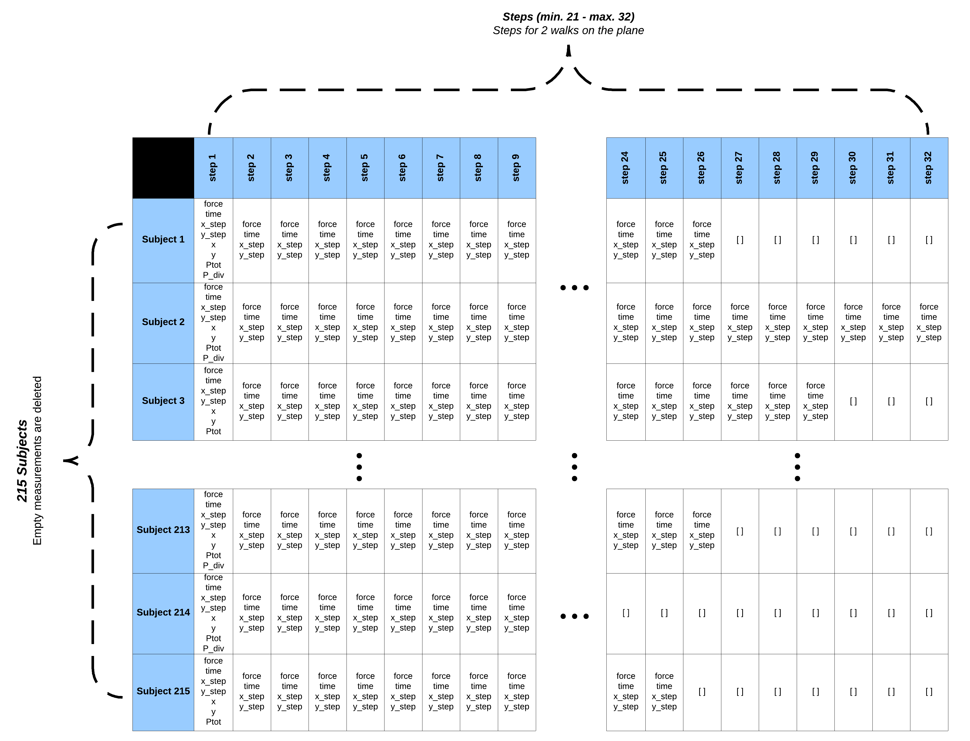
The Database - Example

Slide 5
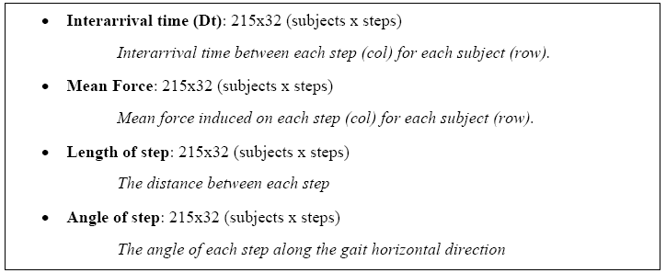

Variable Extraction
Computation of each step’s necessary variables based on the database samples
Interarrival time between steps ($Dt$)
Mean vertical force induced in the floor on each step (mean force)
The traversed distance between steps (length)
The step angle along the gait horizontal direction (angle)
Extraction of unified table X ($32$x$4$x$215$)
Steps
Pedestrians
Dt-meanF-length-angle

Slide 6
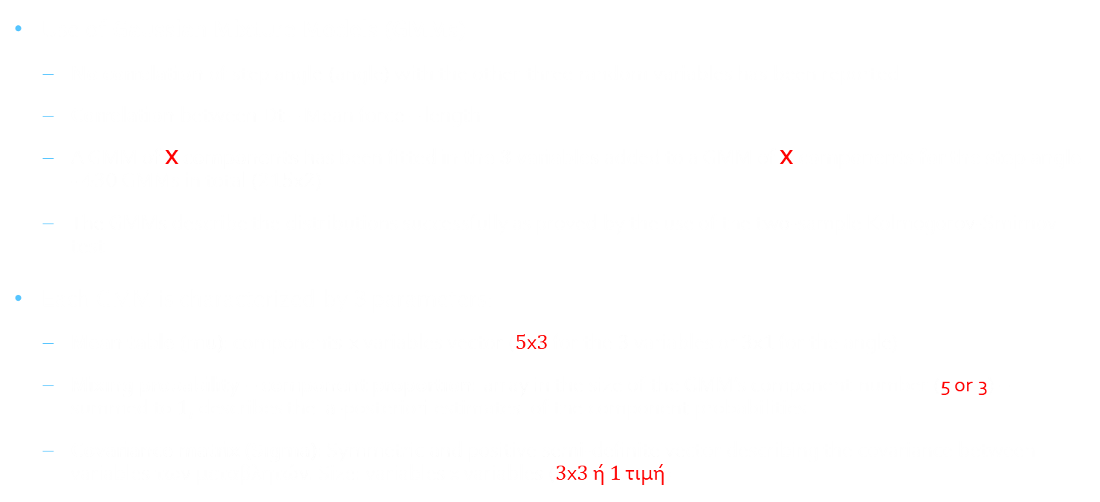
Variable Modeling
Use of Gaussian Mixture Models (GMMs)
No correlation of step angle (angle) with the other three random variables has been reported
Correlation between Dt – Mean force – length
A GMM of X components has been fitted in the $3$ variables added to a GMM of X components for the step angle - $430$ GMMs in total ($215$x$2$)
The GMMs describe the distributions successfully as proved by the use of the two-sample Kolmogorov-Smirnov test
Each GMM is characterized by $3$ parameters:
Mean table (mu): components x variables vector ($5$x$3$ for the $3$ variables or $3$x$1$ for the angle)
Mixing probability – component proportion: array in the size of the GMM’s component number (5 or 3) – summed to $1$, describes the a-posteriori estimates of the component probabilities
Covariance matrix (Sigma): Symmetric and positive semi-definite vector describing the covariance between variables των μεταβλητών. Size: variables x variables ($3$x$3$ ή $1$ τιμή)

Slide 7

Parameter Modeling
Modeling the $3$ GMM parameters in order to extract a complete statistical model that describes the human gait
GMMs have been used for the parameter modeling once again
Modeling mu:
Separate GMMs for each variable’s mu have been fitted
One GMM for each component of each variable
Unification and sorting of mus in order to acknowledge the small values
Therefore, $5$ GMMs have been fitted for each of the $3$ variables Dt, meanF, length and $3$ GMMs for the angle – Total: $18$ GMMs for the mu modeling

Slide 8

Parameter Modeling
Modeling mixing probability – component proportion:
A GMM describing the component proportion of each component has been fitted
Correlation with mu values – During mu’s sorting, the proportions are shifted to correpsond to the components mus
Thus, $5$ GMMs describing the $3$ variables Dt, meanF, length and $3$ GMMs for the angle have been fitted – Total: 8 GMMs to describe the component proportion
Modeling Sigma:
A GMM for each critical value of Sigma has been fitted, i.e. for GMMs describing $3$ variables, a$3$x$3$ matix containing 6 critical values is required
6 critical values: the matrix diagonal and the covariances between 1st -2nd, 1st - 3rd and 2nd - 3rd variable
Unified covariance matrices containing the critical values have been created
Concluding, 6 GMMs describing the $3$ variables Dt, meanF, length and $1$GMM GMMs for the angle have been fitted – Total: $7$ GMMs to describe Sigma

Slide 9
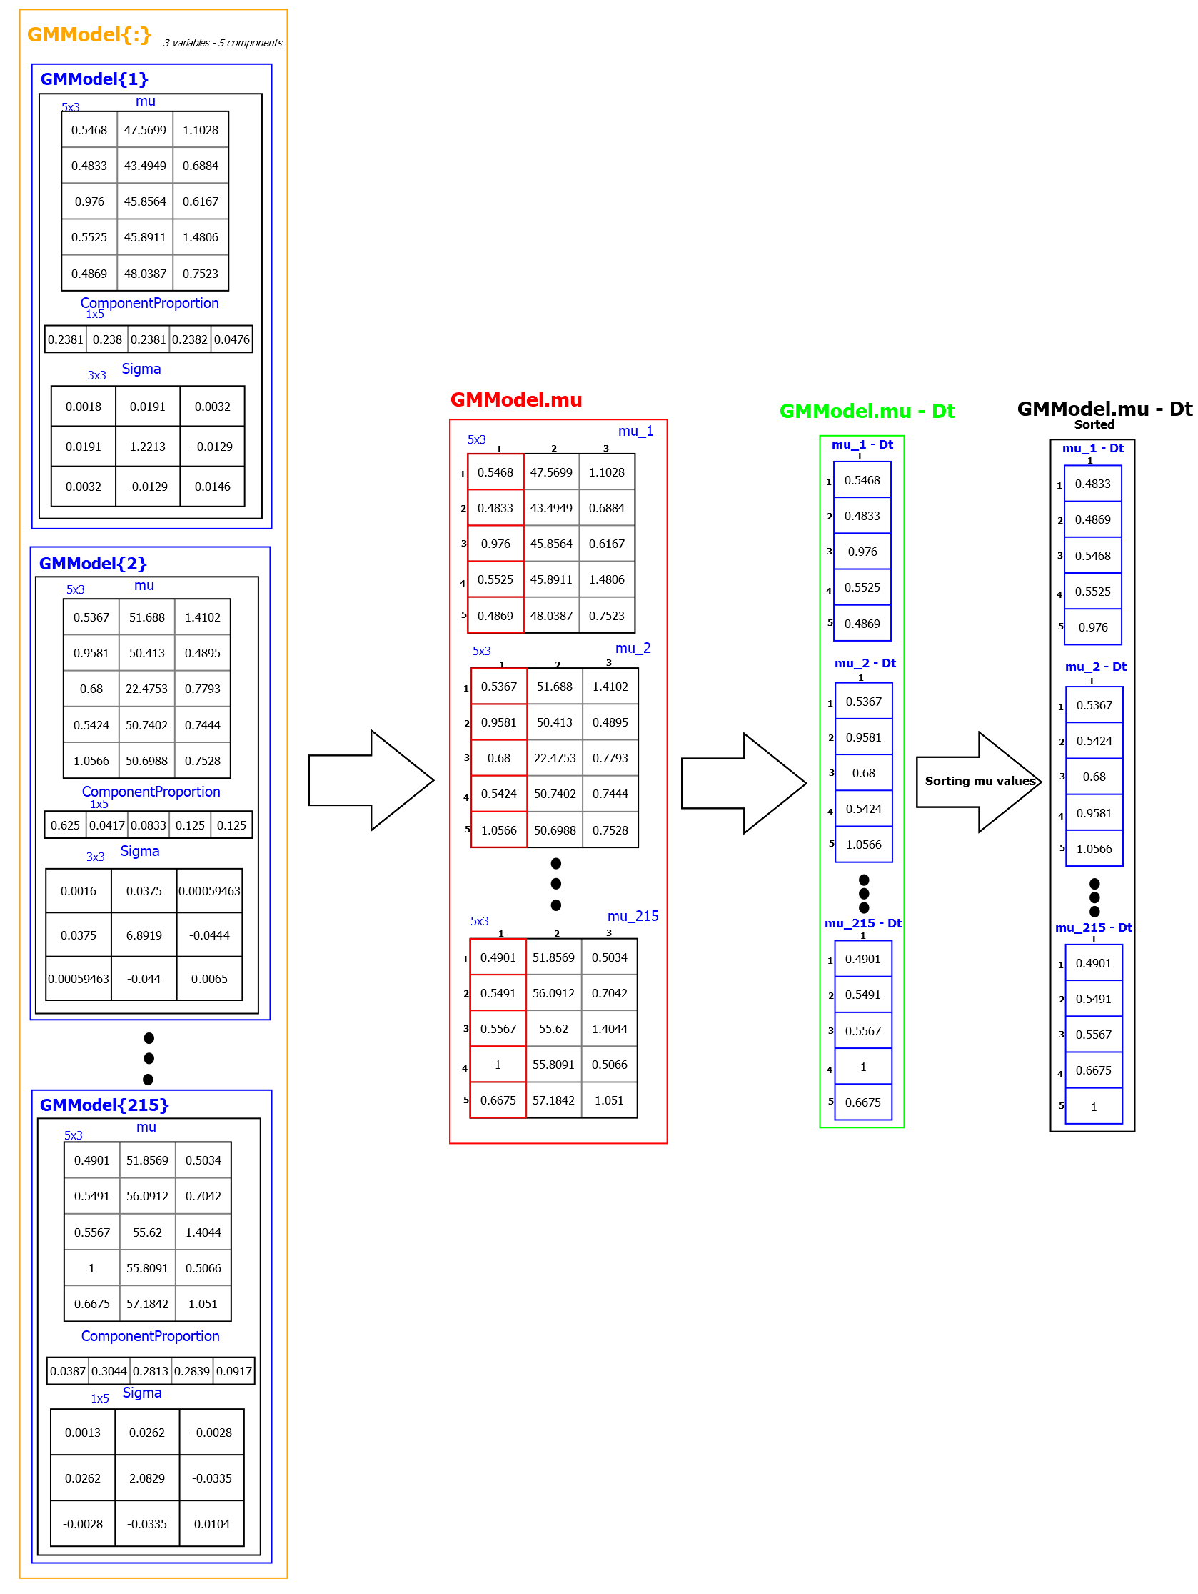
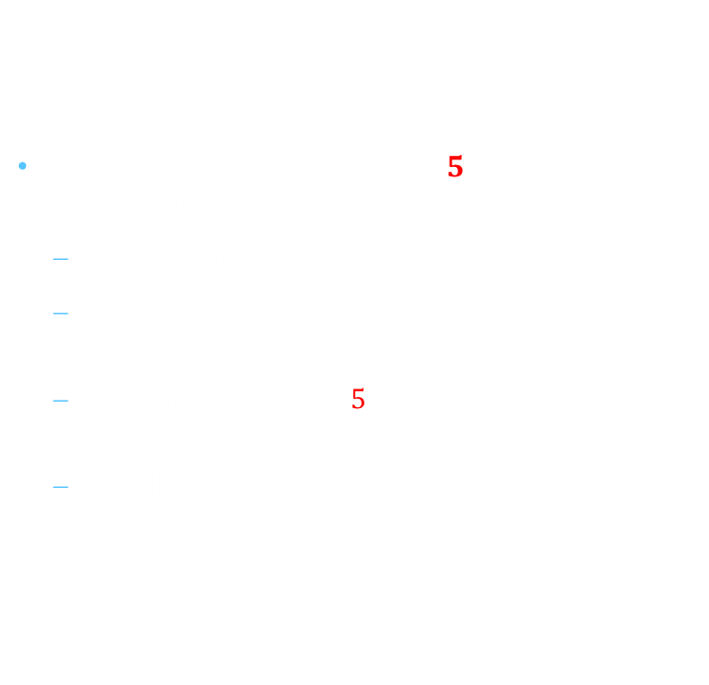
Modeling mu - Logic
Modeling mean values of the $5$ components describing $Δt$
The same procedure is followed for meanF, length
Each first column’s values are corresponding to the mean value of each component describing $Δt$
Modeling each of the $5$ values describing each variable
Initially, ascending sorting of the variable’s mean values is performed

Slide 10
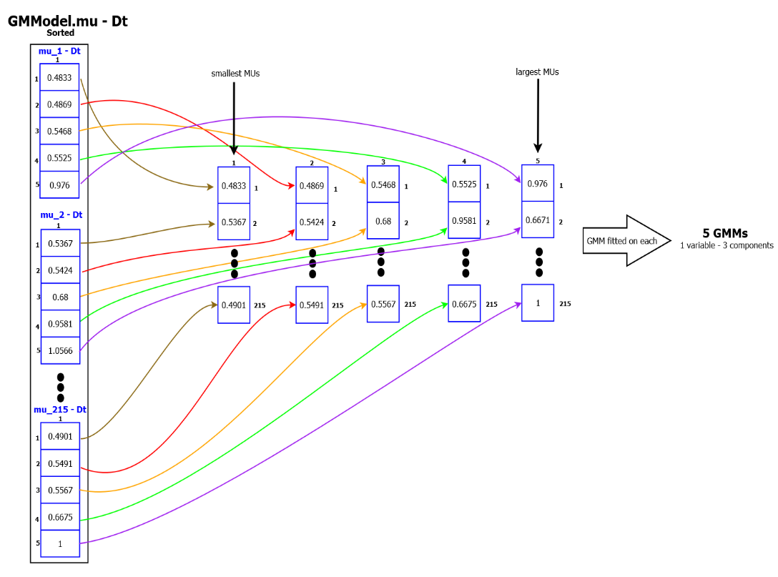
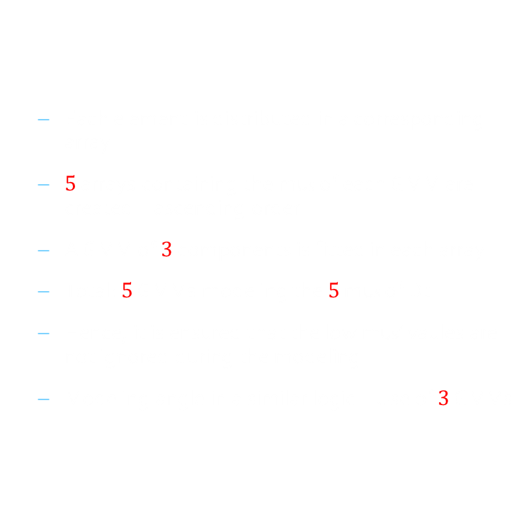
Modeling mu - Logic
Each element is distributed in a corresponding array
$5$ arrays containing the mus of each GMM are created – ascending order
A GMM of $3$ components is fitted in each array
Total: $5$ GMMs modeling the $5$ mus of Dt
Hence, it is ensured that the low mus’ vaules are not ignored during the modeling
Modeling angle in a similar logic – Use of $3$ GMMs

Slide 11
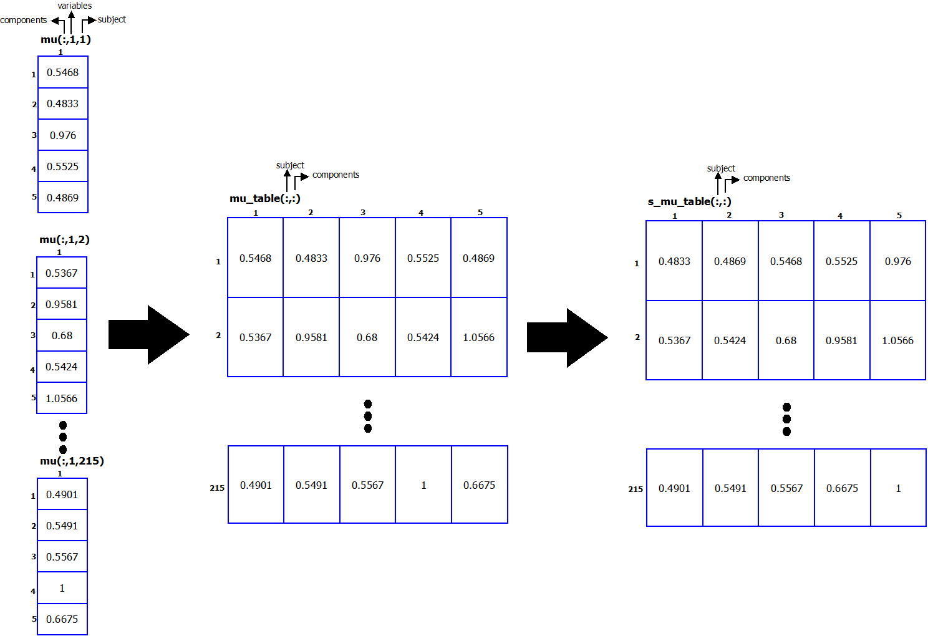
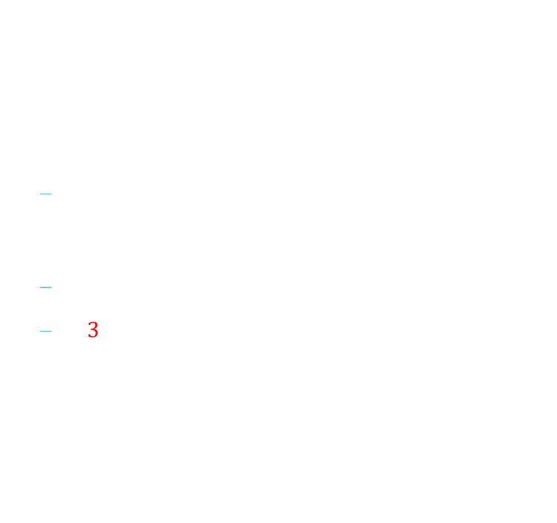
Modeling mu - Implementation
A common $215$x$5$ mu vector that includes each component’s mu values is created for each GMM ($Δt$ variable)
Ascending sorting of rows is performed
A $3$ component GMM is fitted in each row

Slide 12
Modeling mu - Plot

Slide 13
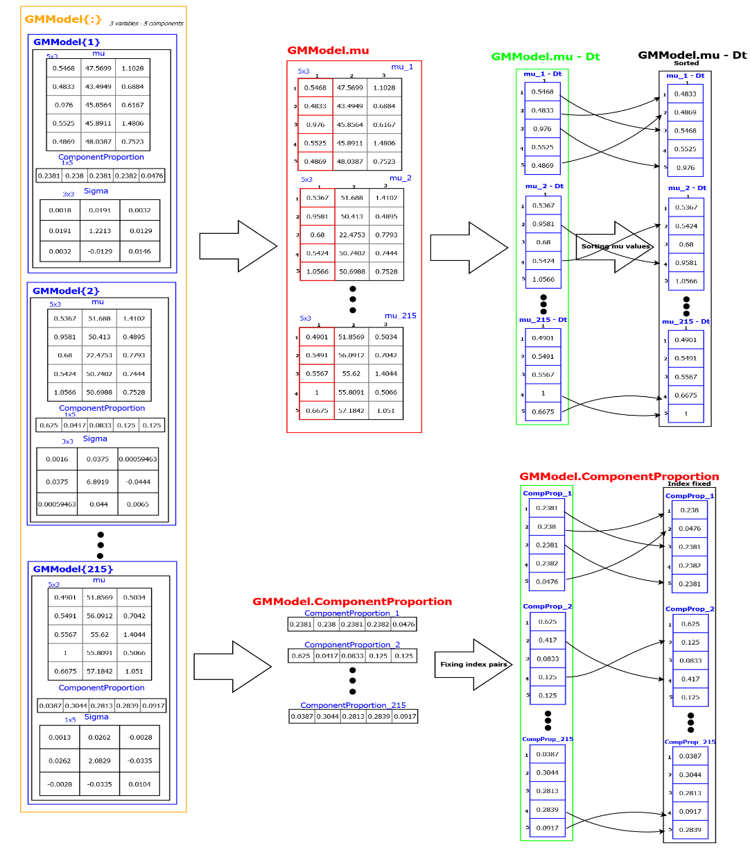
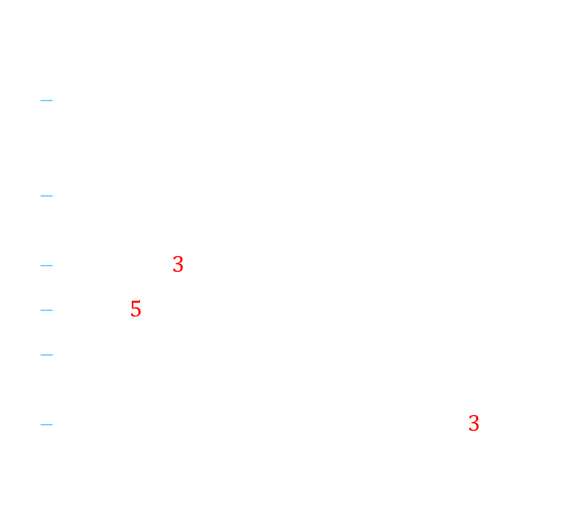
Modeling Mixing Probability - Logic
During the sorting stage of mu modeling, the mixing probability values are shifted to correspond to the sorting’s modified indexes
Each element is allocated in an array in the same manner as mu’s modeling
A GMM of $3$ components is fitted in each array –
Total:$5$components modeling mixing probability
Hence, the correspondence with each component mus is ensured
Modeling angle in a similar logic – Use of $3$ GMMs

Slide 14
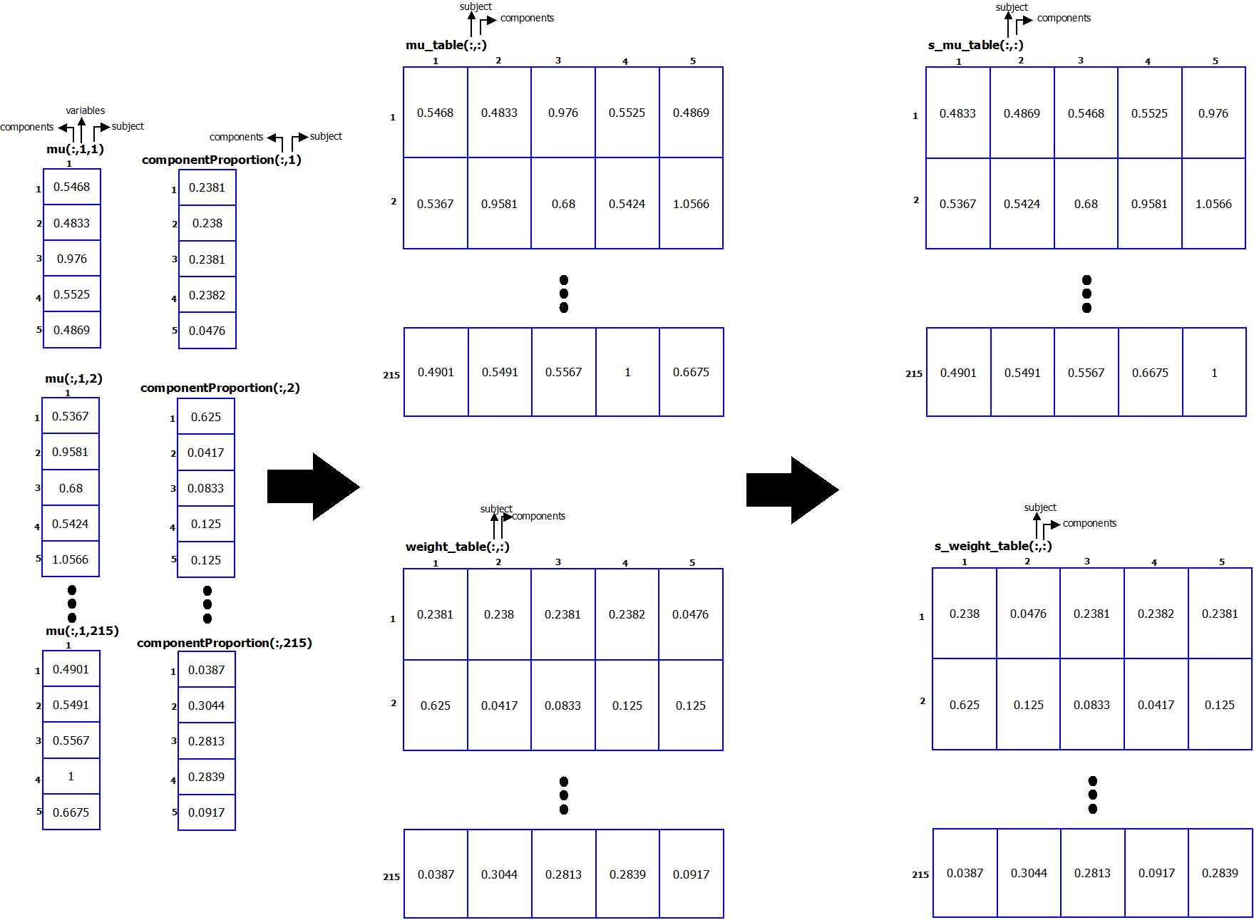

Modeling Mixing Probability – Implementation
A common $215$x$5$ weight vector containing mixing probabilities of each component for each GMM is created
Index pairing based on mu’s sorting is performed
A GMM of $3$ components is fitted in each row

Slide 15
Modeling Mixing Probability – Plot

Slide 16
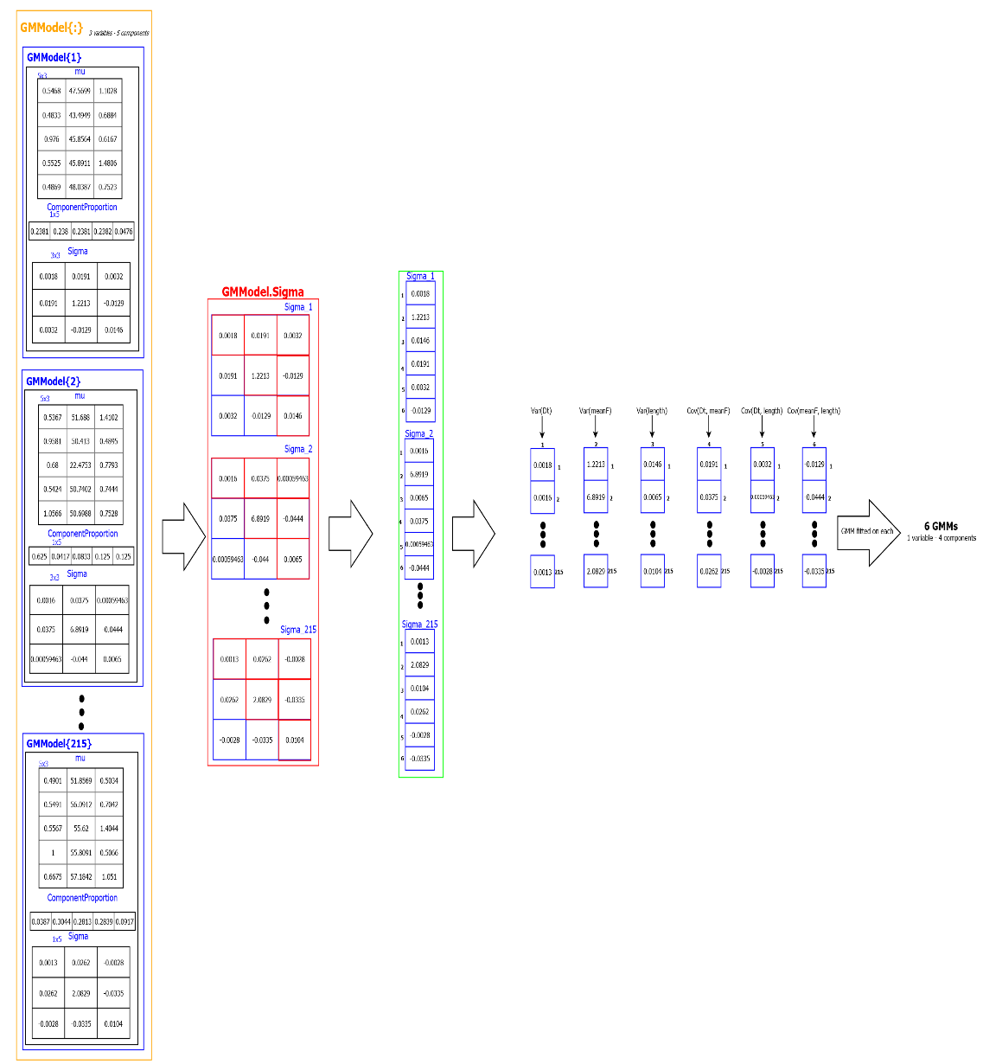
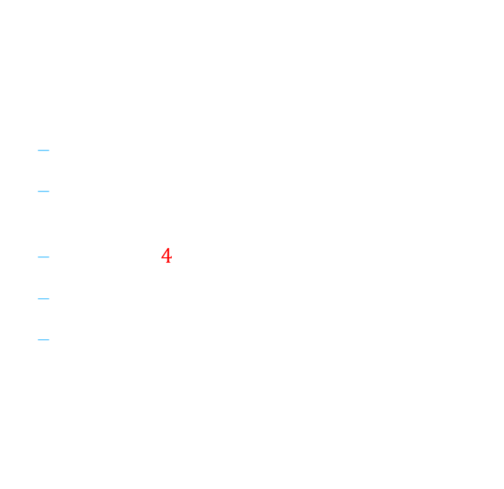
Modeling Sigma - Logic
Symmetric $3$X$3$ matrix – 6 critical values
Each variance/covariance value is matched to an array
A GMM of $4$ components is fitted in each array
Total: 6 GMMs modeling Sigma
Angle: $1$ GMM in variance values is fitted

Slide 17
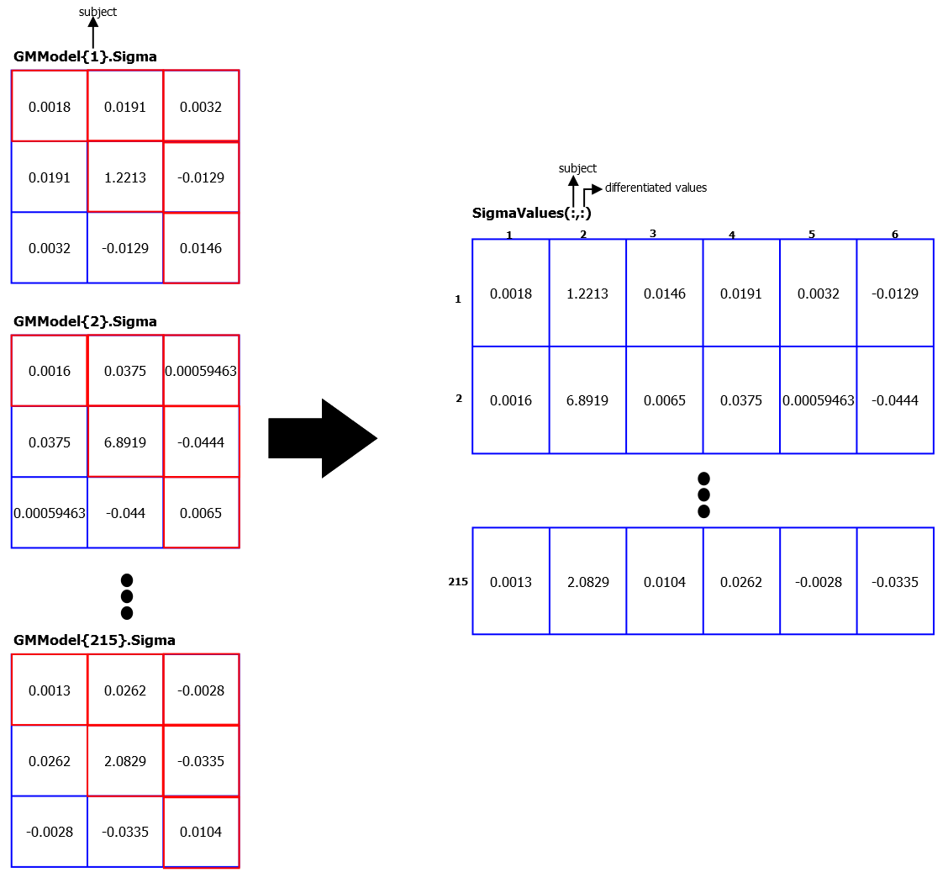
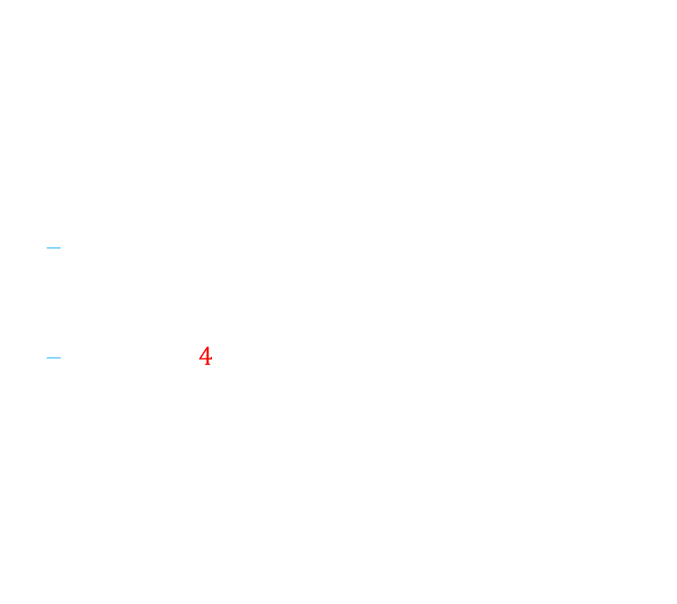
Modeling Sigma – Implementation
A common $215$x6 Sigma vector containing the variable variance/covariance values is created for each GMM
A GMM of $4$ components is fitted in each row

Slide 18
Modeling Sigma- Plot

Slide 19
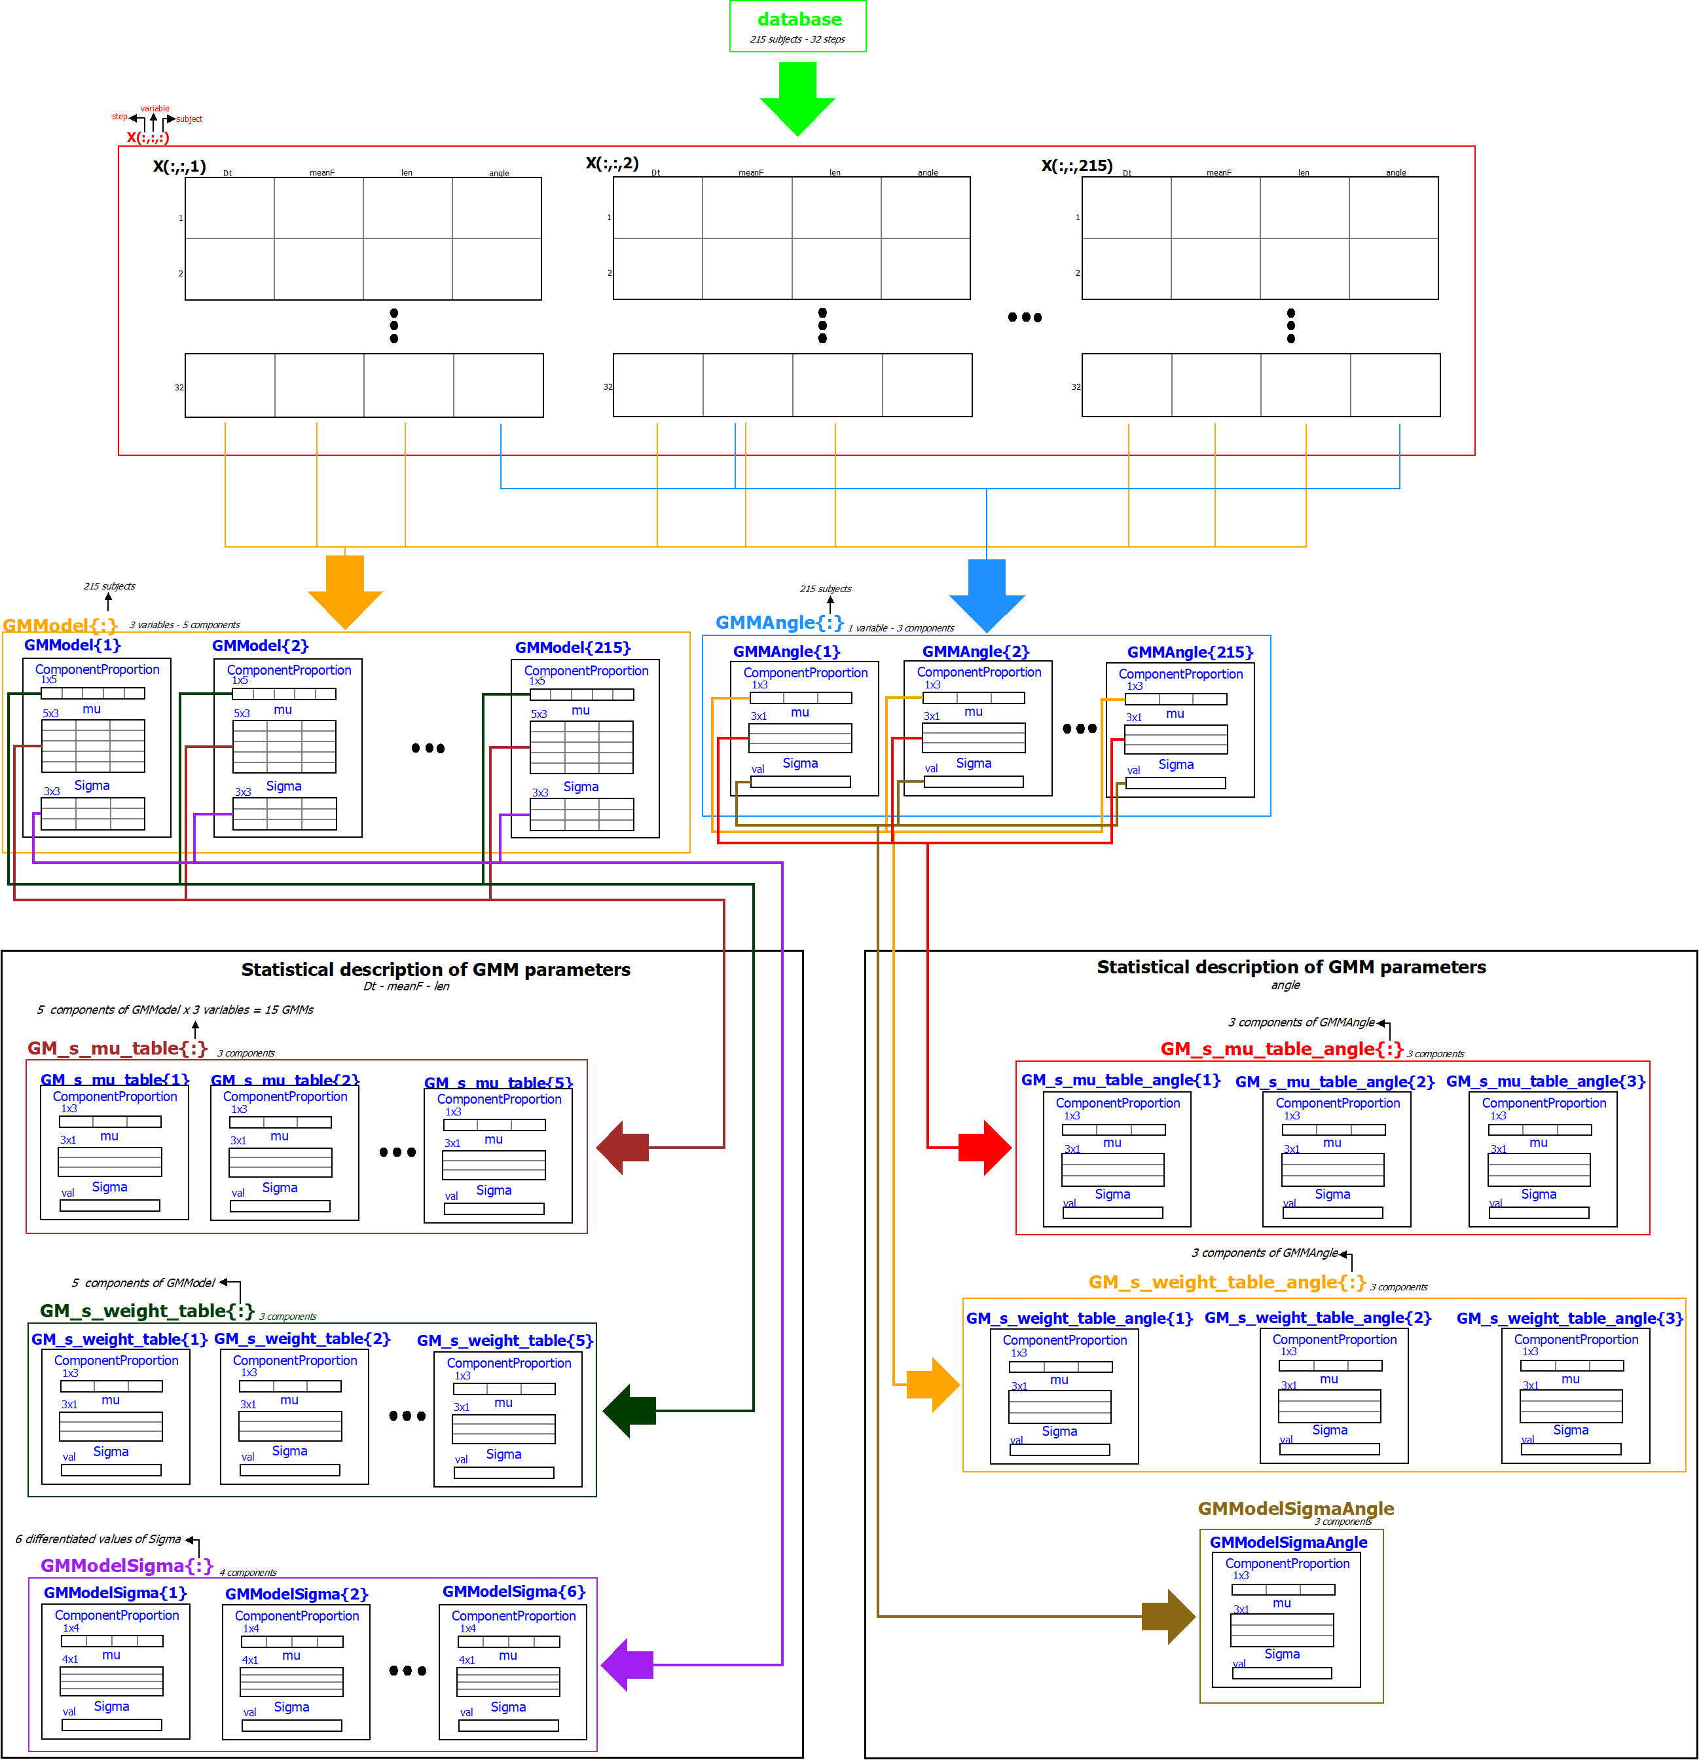
Modeling Overview
Variable Extraction
Variable Modeling
Parameter Modeling

Slide 20

Developing a Simulator
Extraction of the $4$variables describing a gait of $n$ steps based pm the statistical model
A reversed procedure is followed
The $3$ parameters (mu, mixing probabilities and Sigma) are generated randomly using the GMMs describing them
A GMM is fitted using the $3$ generated parameters. This GMM constitutes the distribution that describes the human walk
n sets of $3$ variables(Dt, meanF and length) are generated using this GMM
The same procedure (fitting of one more GMM) is performed in order to extract the step angle using the corresponding GMMs describing these parameters

Slide 21
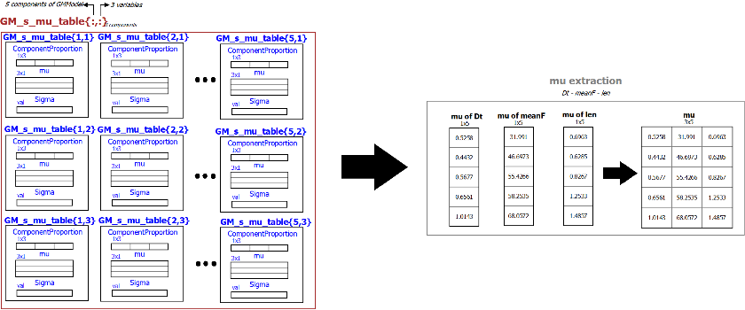
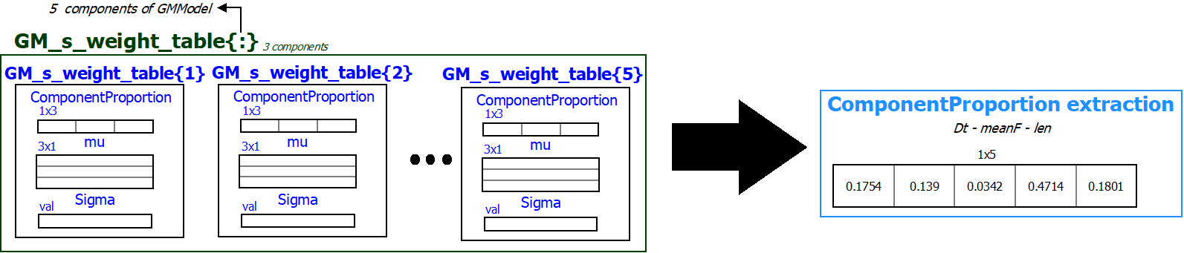
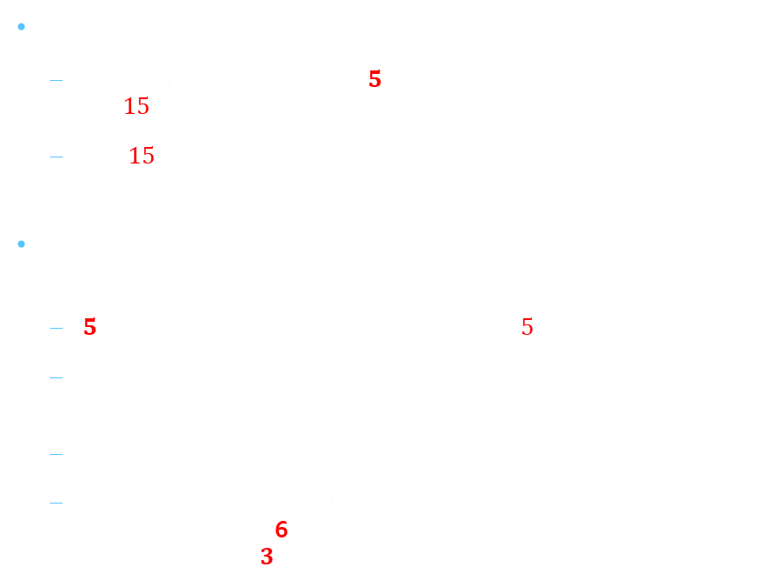
Parameter Extraction
Extraction of the mean table (mu)
$\text{F}\text{or} \text{each} \text{of} \text{the} 3 \text{variables}\text{, }5$ random values are generated using the $15$ GMMs
The $15$ generated values constitute the mu parameter of the GMM describing the $3$ variables
Extraction of mixing probability – component proportion array:
$5$ random values are generated using the $5$ GMMs
These generated values constitute the mixing probability parameter of the GMM describing the $3$ variables
A normalization of the values is conducted in order to sum to $1$
For the extraction of mus and mixing probabilities describing the angle of step, the 6 GMMs are used respectively for the extraction of the$3$values of each parameter

Slide 22
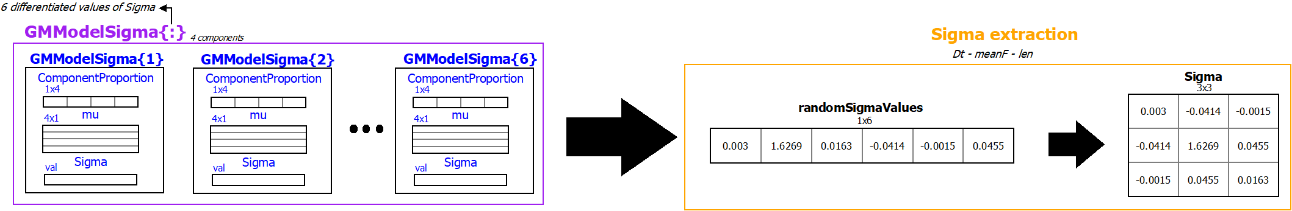

Parameter Extraction
Extraction of the variance/covariance table (Sigma)
Using the $6$ GMMs describing Sigma, $6$ random values are generated for $Δt, F, l$
The first $3$ values constitute the matrix diagonal, while the $3$ values remaining describe the covariances between the $3$ variables
This procedure is repeated until a symmetric positive semi-definite matrix is generated
For the extraction of Sigma describing the angle of step, the counterpart GMM describing it is used

Slide 23
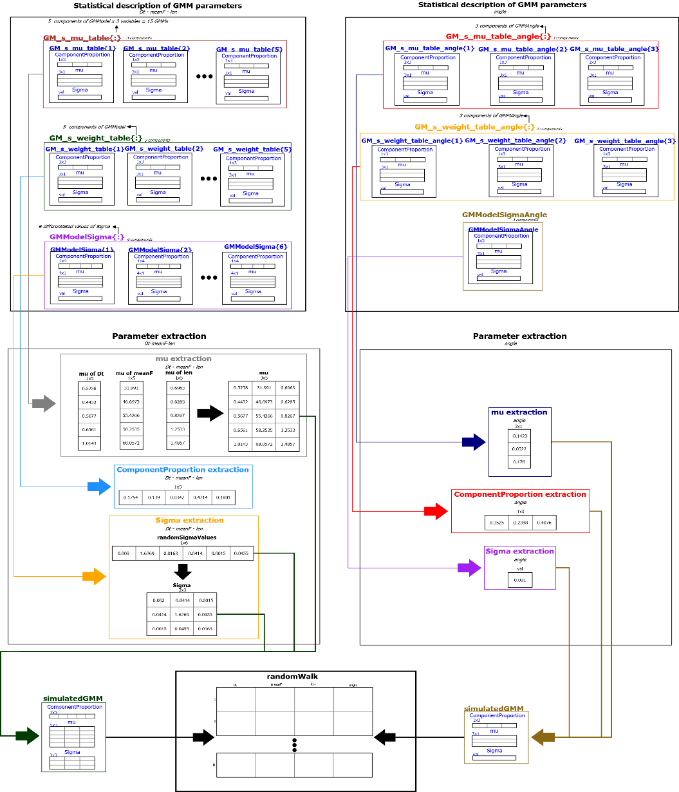

Extraction of Random Walk
$2$ GMMs are fitted using the generated parameters
$n$ random sets of variables are generated using these GMMs (Dt, meanF and length using the $1$^{st} and angle of step using the $2$^{nd})
The join of those sets describes a random walk of $n$steps

Slide 24

Evaluation of Simulation
The simulated results approach the experimental quite effectively
Notable difference in the mean force values due to different body types affecting the measurements
The mean velocity of the simulated gait has been calculated as $4.4 km/h$. This values approaches the mean velocity of human walk at a normal tempo
The two plots depict the simulated gait in comparison to the experimental
Innovative approach
No other research work has used GMMs for the modeling of human walk
First work that conceives the human walk as a random process
Uses large amount of experimental samples
Thus, using this approach, the experimental procedure can be omitted in future researches

Slide 25
Future Goals
Apply the simulator in a digital pedestrian walkway developed by the Civil and Environmental Engineering Department of University of Modena & Reggio Emilia (Dipartimento di Ingegneria "Enzo Ferrari”) in order to conduct research on bridge oscillations and the resonance effect
Publication of research paper that includes this work

